Slide 1
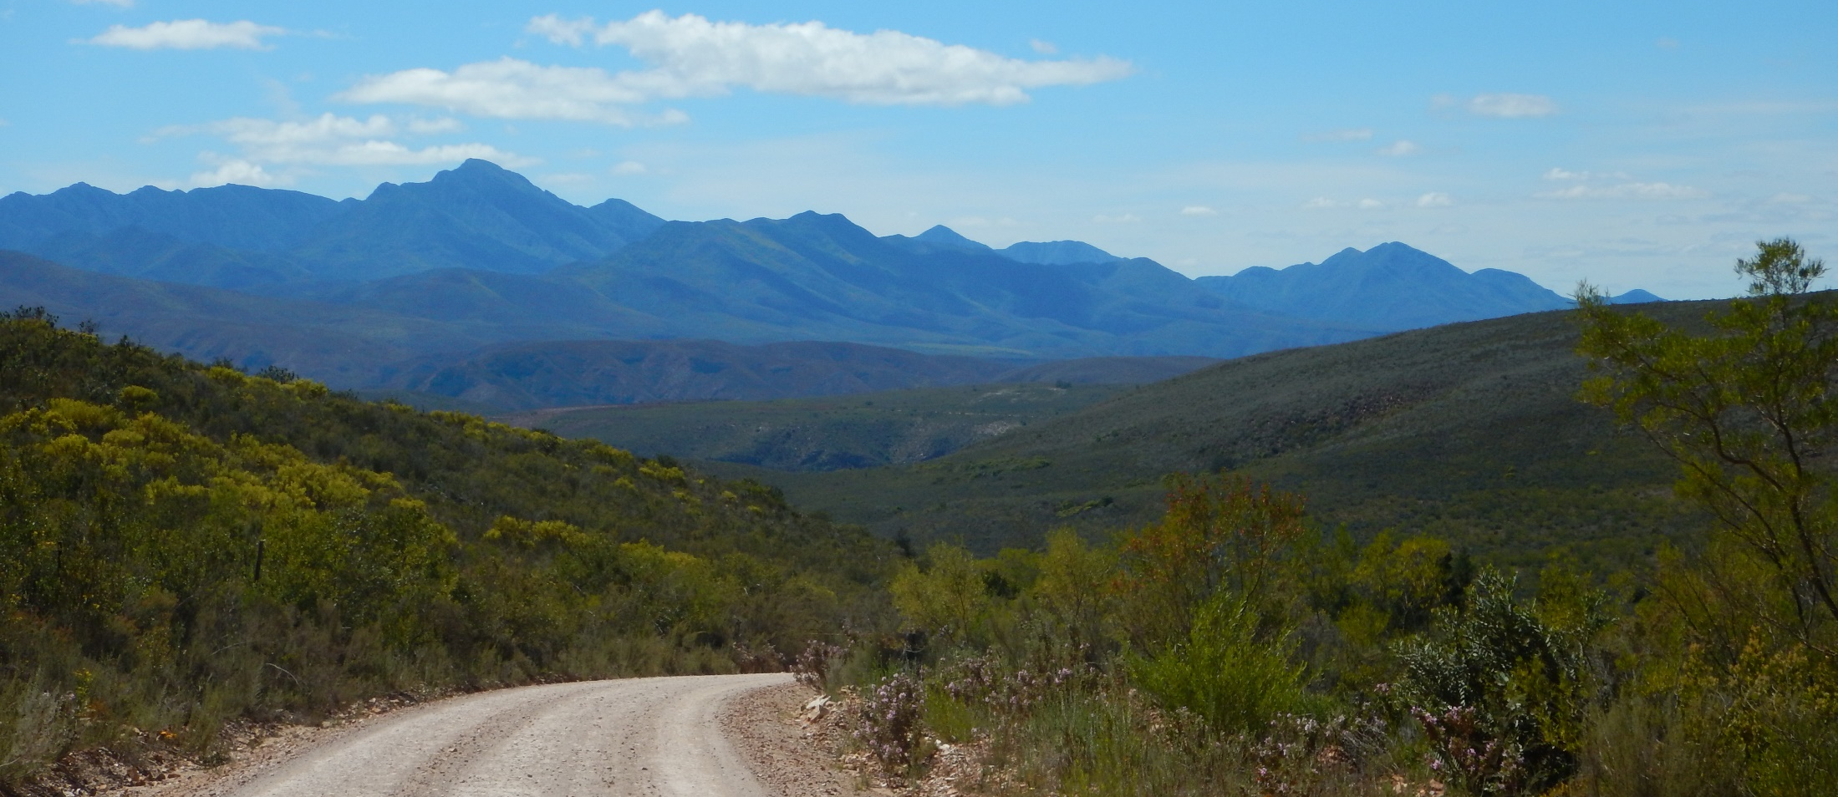
August 2017
Notes:
Welcome

Slide 2
Baviaanskloof: Excavator
Notes:
Trialling new innovative ways of rehabilitation

Slide 3
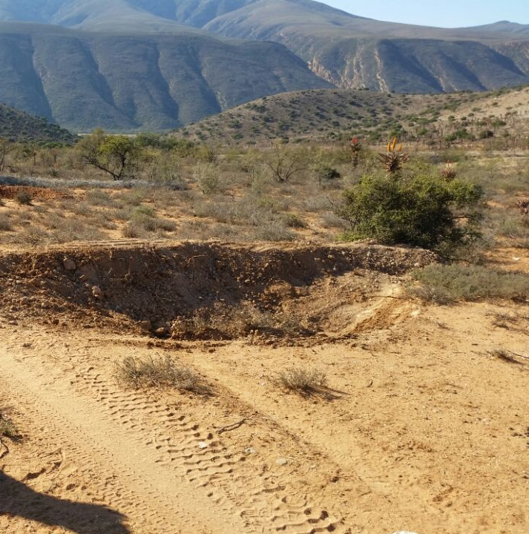
Baviaanskloof

Slide 4
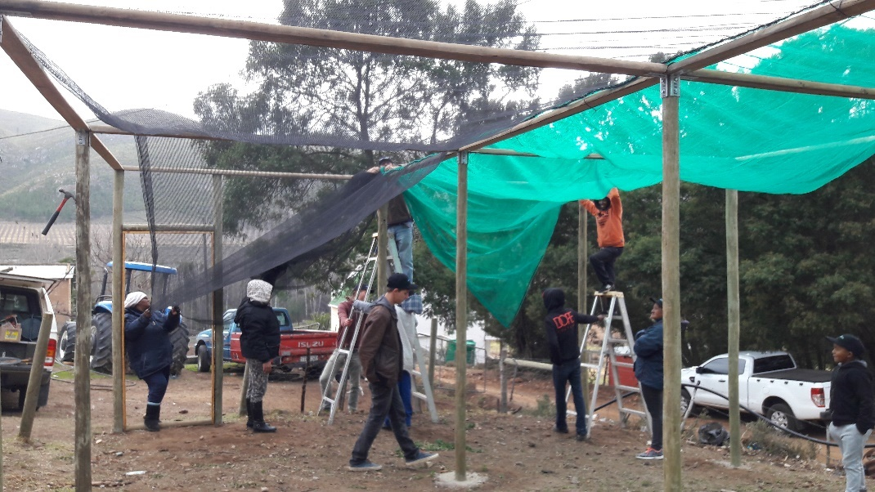
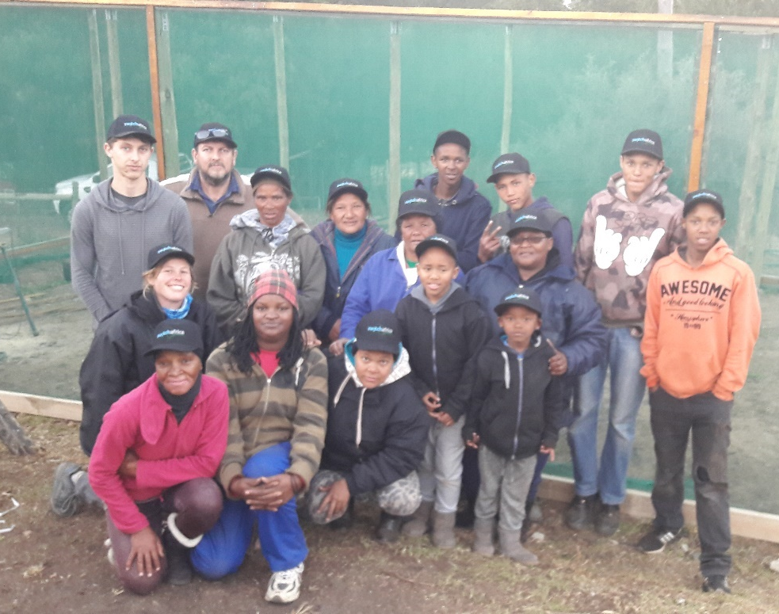
Langkloof: Nursery
Notes:
Seedling nursery in Haarlem
Veg; experience

Slide 5
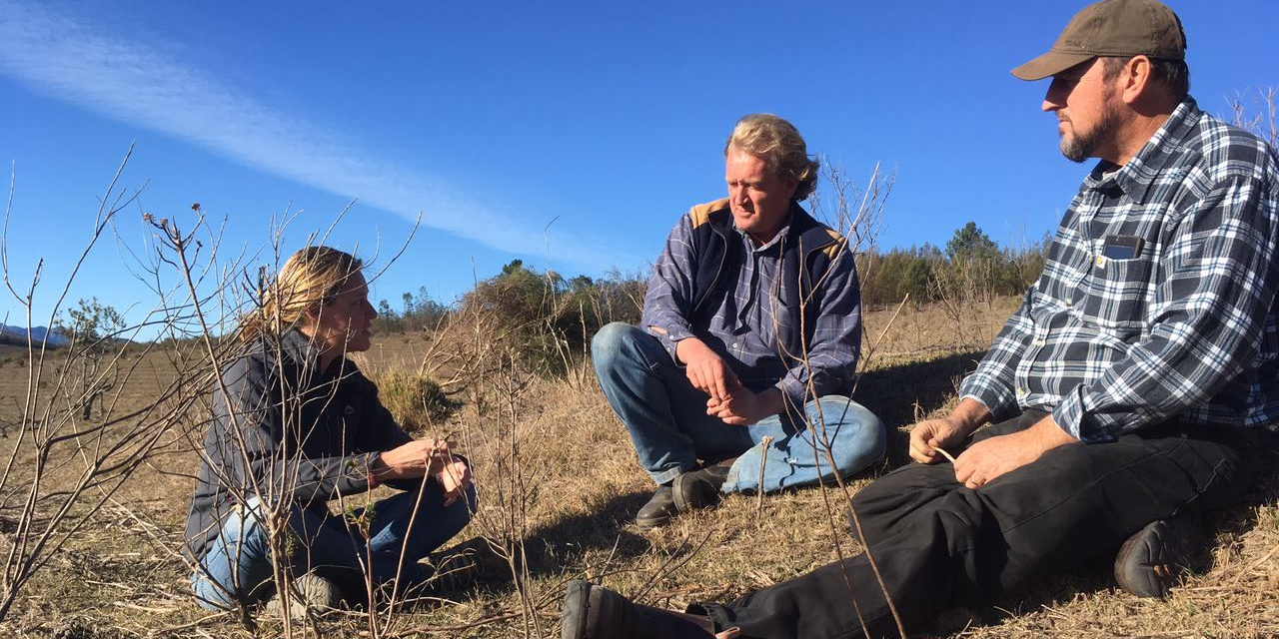
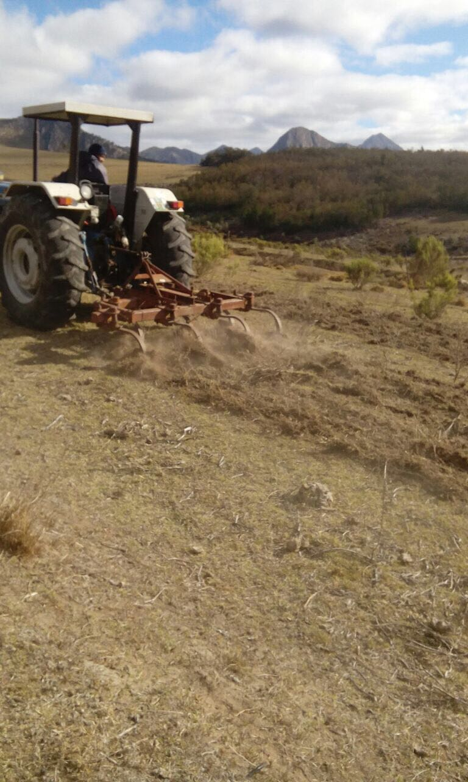
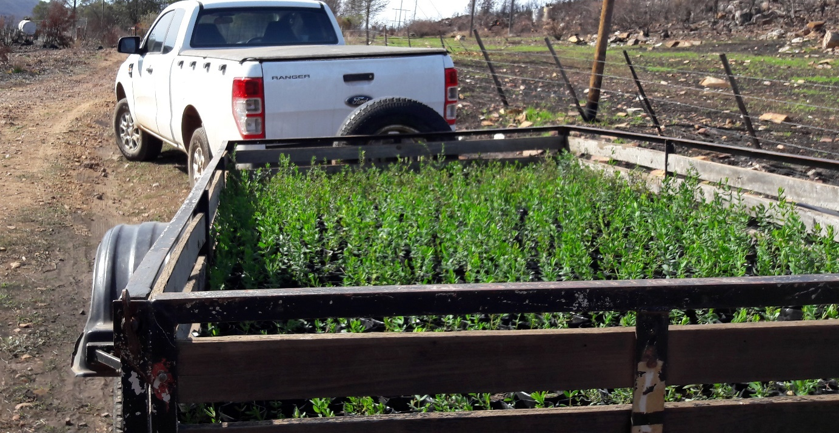
Langkloof: Honeybush Trials
Notes:
Trials
Sceletium
Biofumigation for after wattles removed

Slide 6
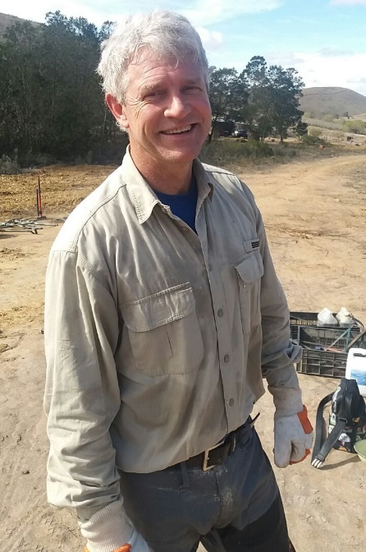
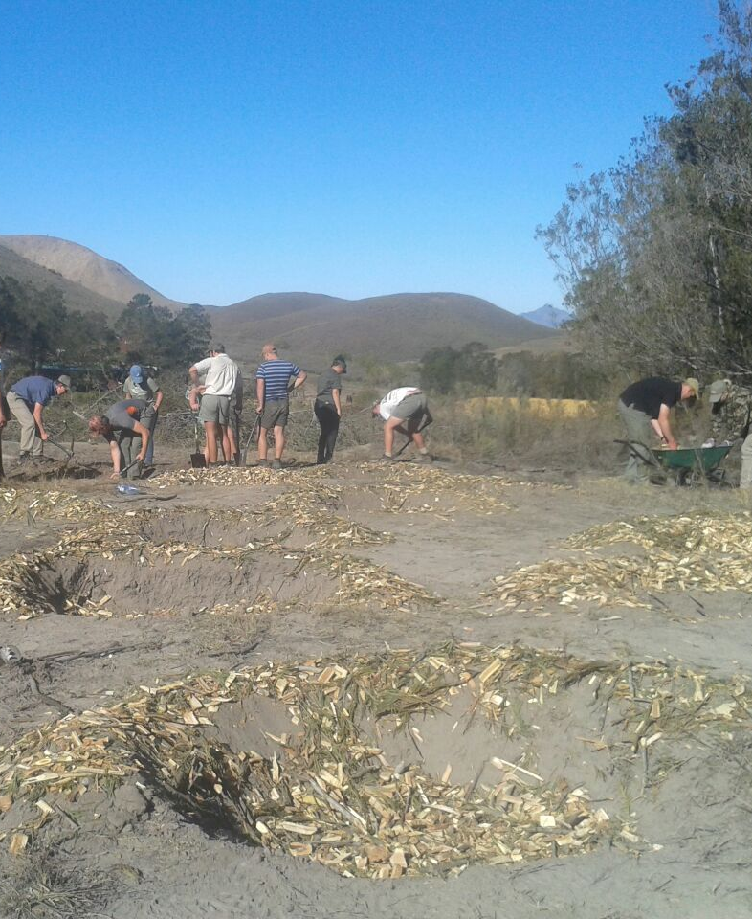
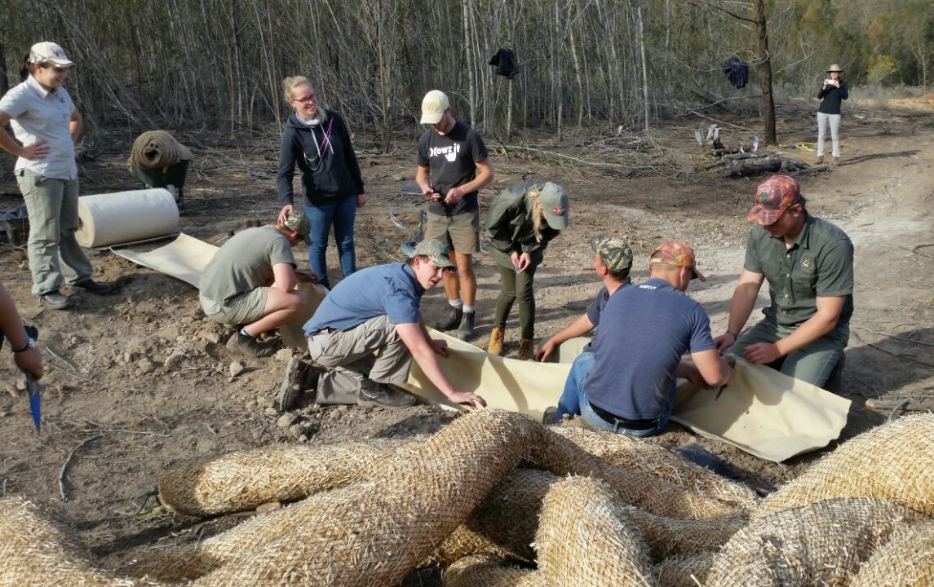
Langkloof: Alien clearing & rehabilitation
Notes:
Thank you GIB & Japie

Slide 7
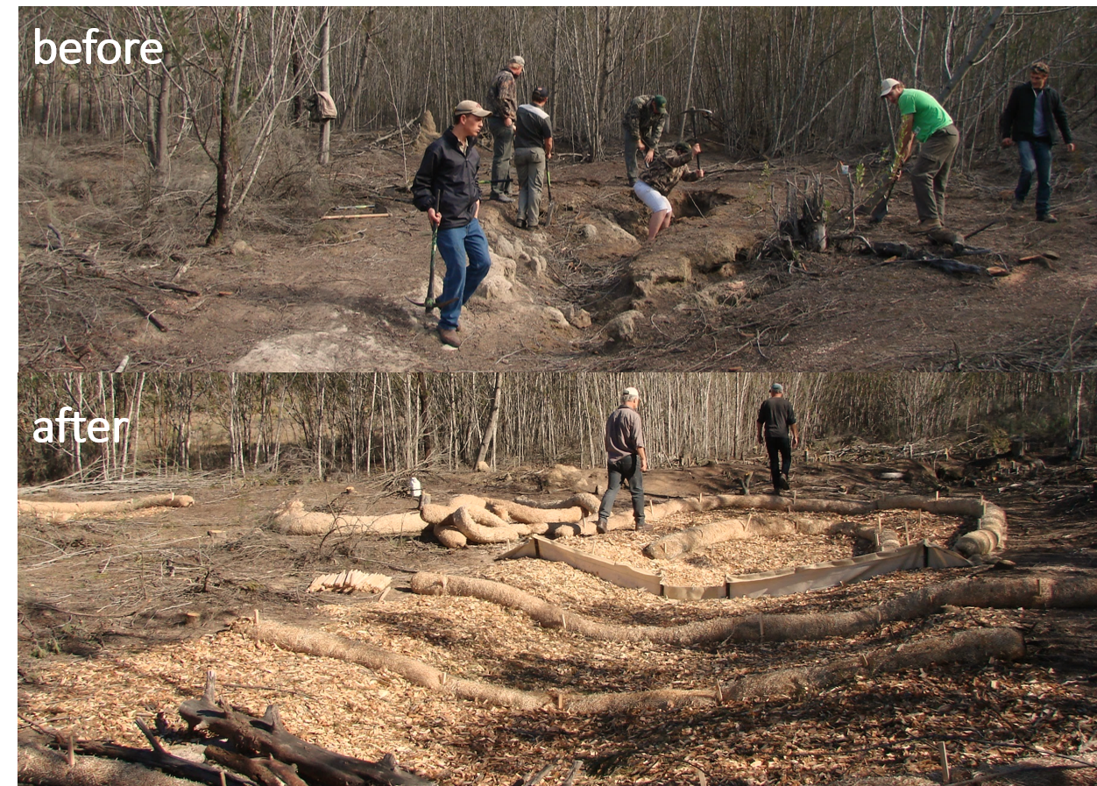

Slide 8
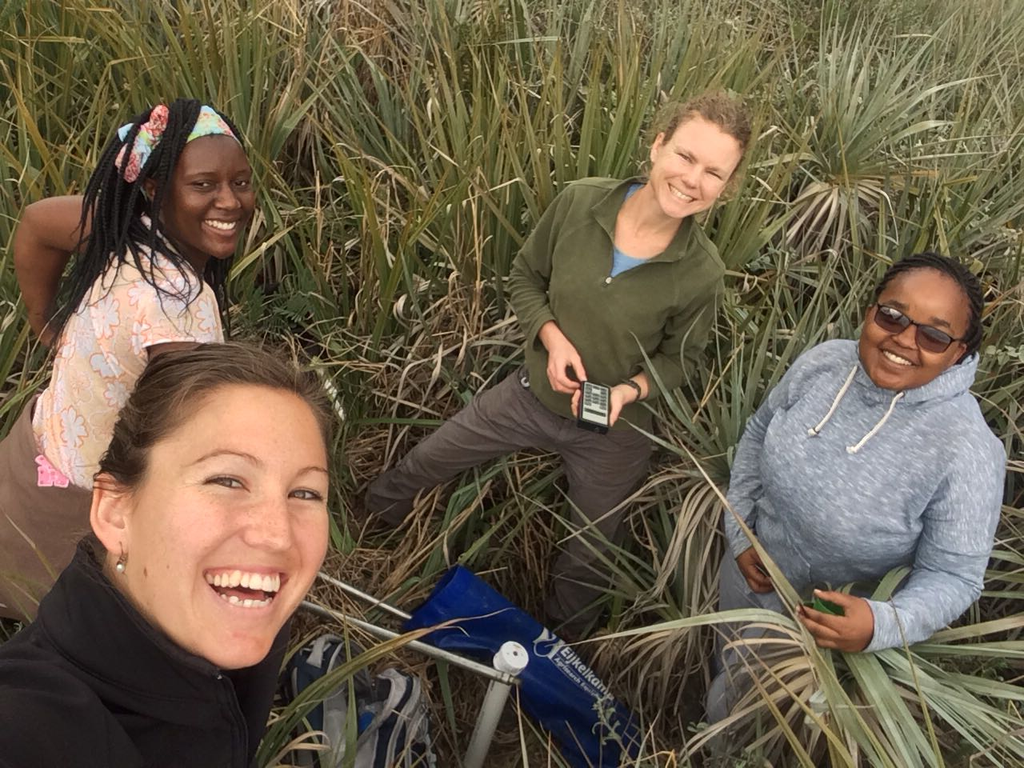
Langkloof & Baviaanskloof: WRC data gathering

Slide 9
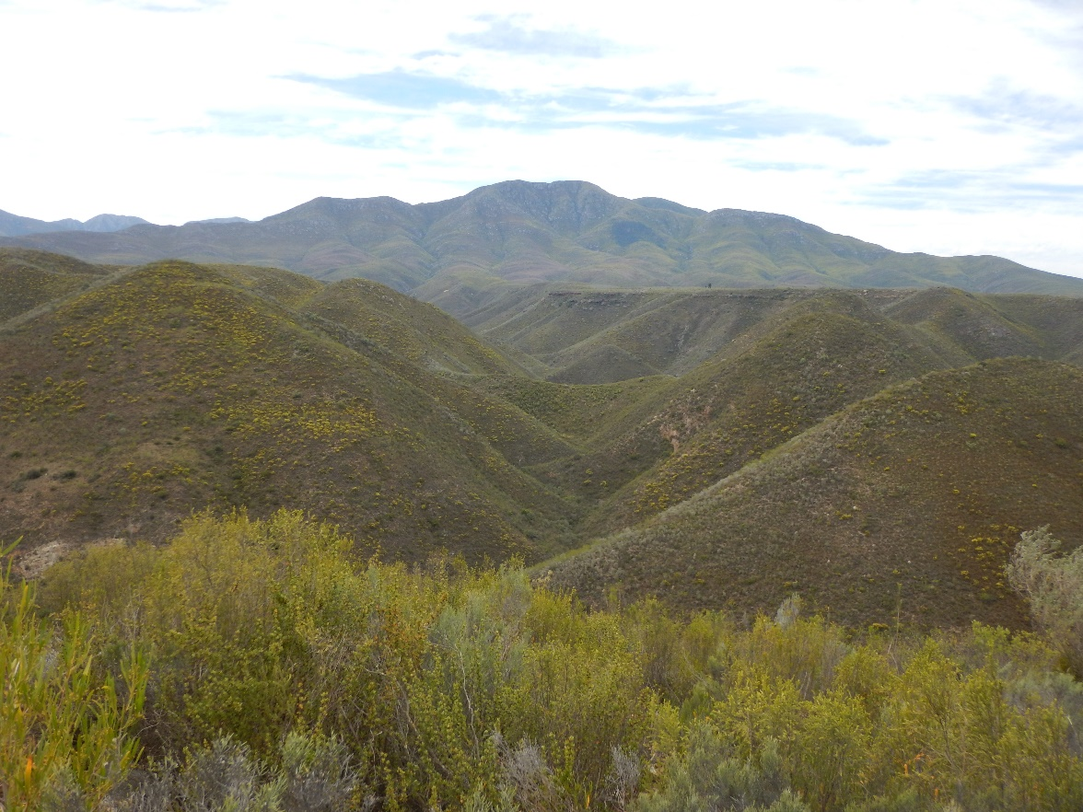
Thank You
Thelani Grant/Ancia Cornelius
thelani@livinglands.co.za/ancia@livinglands.co.za

